Slide 1
Probability and Statistical Inference
Difference
Sources used in creation of this lecture:
Statistics and Data Analysis, Peck, Olsen and Devore; Discovering Statistics Using R
Field, Miles and Field; Understanding Basic Statistics, Brase and Brase;SPSS Survival Manual, Julie Pallant

Slide 2
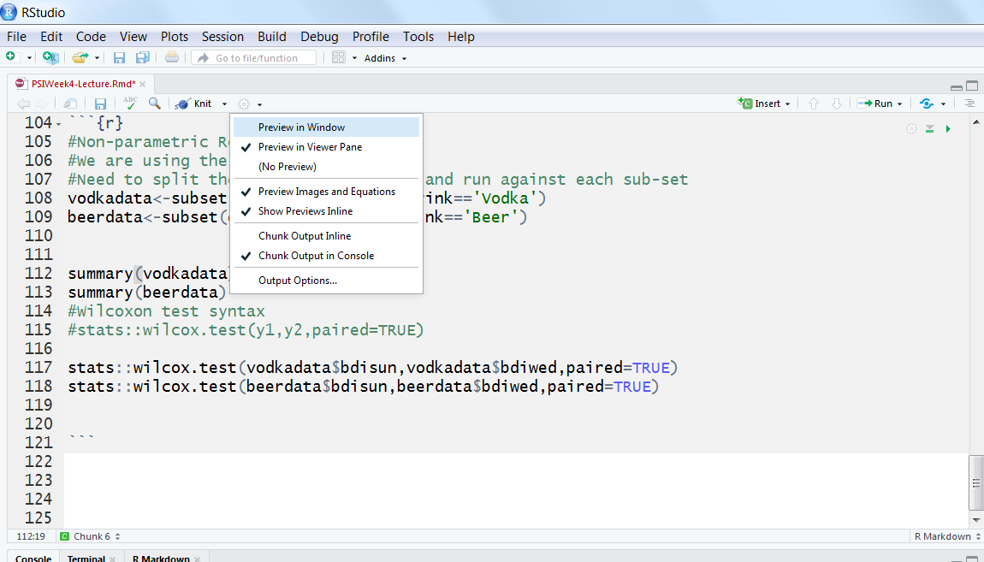
R Studio

Slide 3
Before Inferential Statistics…
We need to establish evidence to support going ahead with building a predictive model
If we are asserting a relationship
We need to investigate if there is any evidence of a relationship using the appropriate test and make a decision based on the results (strength, direction etc.)
If we are asserting a differential effect for different groups
We need to investigate if there is any difference using the appropriate test and make a decision based on the result

Slide 4
Relationships and Causality
How to determine if a relationship is causal?
Identify the directionality of relationships between independent (also called predictor variable) and dependent variables (also called outcome variable) based on research/prior knowledge
Independent Variable hypothesised to cause changes in Dependent Variables

Slide 5
Relationships and Causality
Examples:
Independent Variable | Dependent Variable
Death Penalty | Crime Rate
School Funding | Graduation Rate
Graduation Rate | Crime Rate
Parental Income | Graduation Rate
Parental Educational Level | Graduation Rate
Revision time | Exam Result

Slide 6
Causal Relationship
To assert a causal relationship is to claim that changes in the independent variable create changes in the dependent variable
In practice can only assert that one factor causes change in another when you can satisfy the following criteria:
Association
There must be a relationship between the two variables
Time order
The change in the independent variable precedes the change in the dependent
Non-spuriousness
The effects of a third unmeasured ‘spurious’ factor does not produce the relationship between the two variables

Slide 7
Causal Relationship - Association
Variables correspond to each other in predictable ways
Can be either positive (an increase in one causes an increase in the other)
Or negative (an increase in one causes a decrease in the other)
Many associations are not causal
E.g.
Red cars do not cause more accidents
Rather aggressive drivers are more likely to buy red cars
Aggressive drivers are more likely to be involved in accidents

Slide 8
Causal Relationship – Time Order
Logically when a change in one variable causes a change in another, the change in the independent needs to occur before the change in the dependent
Need to be careful
Even if time order is satisfied, a causal relationship may not exist

Slide 9
Causal Relationship – Non-spuriousness
A spurious relationship exists when two variables appear to be causally related but their relationship can be attributed to a third unidentified variable
E.g.
Ice cream consumption causing drowning deaths
There is an association between ice cream consumption and drowning (more people die during times when a lot of ice cream is being consumed)
Time order can also be satisfied – increase in ice cream sales precede increase in drowning deaths
However, the unmeasured factor here is seasonal temperature
In warm weather more people consume ice cream and swim

Slide 10
Relationships and Causality
Causality
Determining how particular sets of conditions (represented by variables) lead to particular outcomes (also represented by variables)
Seldom are relationships deterministic
Everyone completing a university degree will have a higher income than those who do not (unlikely to be true)
Most are probabilistic
i.e. factors increase or decrease tendency towards particular outcomes
Those with a university degree tend to earn more than those who do not
University education is a factor that pushes another factor (income) in a predictable direction

Slide 11
Difference

Slide 12
Alternatives to plyr and dplyr for frequencies
To create a frequency table
table(x,y)
To include percentages (table of proportions)
prop.table(table(x,y))
prop.table(table(x,y),1) # row percentages
prop.table(table(x,y)) #column percentages

Slide 13


Comparison between Samples
Sometimes we want to investigate if an effect is different for different groups within our population
There are a range of statistical tests we can use. The choice depends on:
The measurement of the variable
The shape of the data
Are these groups different?
Notes:
Usually, you only have access to samples which means you never capture a population as a whole
Need to be careful that your samples is representative of your population

Slide 14



Tests for Group Comparison
 | Independent Samples | Related Samples also called dependent means test
Interval measures/ parametric | Independent samples t-test* | Paired samples t-test**
Ordinal/ non-parametric | Mann-Whitney U-Test | Wilcoxon test
* 2 different groups of participants
** 2 same participants measured at two different points
Notes:
There are lots of different types of t-tests, which need to be used depending on the type of data you have
(equal) interval measures
Scales in which the difference between consecutive measuring points on the scale is of equal value throughout
No arbitrary zero, ie positive and negative measures, eg temperature
Ordinal measures
Scales on which the items can be ranked in order
There is an order of magnitude but intervals may vary, ie one item on the scale is more or less than another but it is not clear by how much as this cannot be measured
Often statements/ feelings are attached to numbers which can then be used for rating; in fact, this data can only be ranked (from highest to lowest) , ie what score had the highest turn-out
1= very good, 2= good, 3= neutral, 4= bad, 5= very bad
Different measurements have a direct influence on the way analysis is conducted because some of them are more amenable to mathematical operations than others

Slide 15

Parametric: t-tests
comp
infer
12
10
95% CI
8
6
Left hemisphere
right hemisphere
Exp. 1 Exp. 2
lesion site
Compare the mean between 2 samples/groups/conditions
If 2 samples are taken from the same population, then they should have fairly similar means
⇨ if 2 means are statistically different, then the samples are likely to be drawn from 2 different populations, i.e. they really are different

Slide 16
t Distribution
Very similar to the Z distribution by assuming normality.
Normality is obtained after about 120 data observations.
In which case t = z
Basic rule of parameter estimation:
The higher the observations (N) of sample the more reflective of overall population.

Slide 17
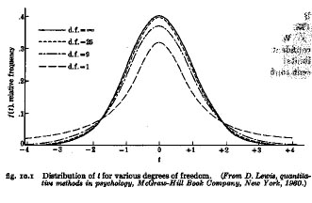
The t Distribution
The t distribution is a short, fat relative of the normal.
The shape of t depends on its degrees of freedom.
As N becomes infinitely large, t becomes normal and becomes z

Slide 18
t distribution critical values table
Only need to check if your sample is smaller than 120
https://www.easycalculation.com/statistics/t-distribution-critical-value-table.php
Your statistical tool will do this look up for you and calculate whether your test is statistically significant or not.

Slide 19


Comparison between Conditions
Is the activation (from MRI) different when you compare 2 different conditions?
Reading aloud (script) vs “Reading” finger spelling (sign)
Reading aloud vs Picture naming
Notes:
Is the activation different when you compare 2 different conditions?
Exp. 1: reading script is compared to “Reading” finger spelling (sign)
or
Exp. 2: when picture naming is compared to reading aloud those exact object labels (eg, naming the picture of a tiger versus reading the word “tiger”)?

Slide 20

t-test
Exp. 1
Reading script (blue) is compared to “Reading” finger spelling (green)
Activation patterns are similar, not significantly different
=> they are similar tasks
Exp. 1 Exp. 2
Notes:
or

Slide 21
t-test
Exp. 2
When picture naming (green) is compared to reading aloud (blue) those exact object labels (e.g. naming the picture of a tiger versus reading the word “tiger”)
reading causes significantly stronger activation and this is different to naming
Activation patterns are very (and significantly) different
=>reading aloud different to naming
Exp. 1 Exp. 2
Notes:
or

Slide 22
Formula for test statistic
Difference between the means divided by the pooled standard error of the mean
SE variability between sample means - if large then may be a problem with representativeness of the sample
Reporting convention: t= 11.456, df= 9, p< 0.001
(Remember df depends on the number in your sample)
Notes:
t-value+ an end product of a calculation
df = degrees of freedom (the number of individual scores that can vary without changing the sample mean)
Standard error
Is the standard deviation of sample means
It is a measure of how representative a sample is likely to be of the population
Large SE (relative to the sample mean): lots of variability between means of different samples ⇨ used sample may not be representative of a population
Small SE: most sample means are similar to the population mean ⇨ sample is likely to be an accurate reflection of the population

Slide 23
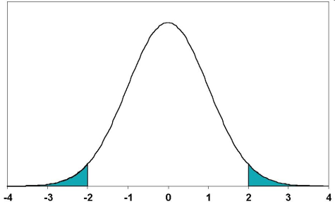


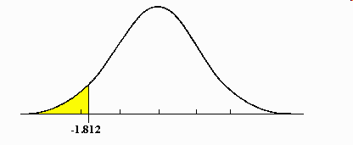
Types of t-tests cont.
2-tailed tests vs one-tailed tests
2 sample t-tests vs 1 sample t-tests
2.5%
2.5%
Mean
Mean
A known value
Mean
5%
Notes:
2-tailed tests vs one-tailed tests
If you set alpha-level at 0.05, there is 5% “area” in which a score would fall (outside where it is expected)
2-tailed tests leave room for this area to occur on both extreme ends, ie improvement may be either positive or negative (ie, 2,5% at either end)
One-tailed tests deny this and assume that the 5% can only occur at one extreme end (5%)
Both tails are meaningful in behavioural studies and should be favoured
2 sample t-tests vs 1 sample t-tests
2 sample t-tests compare the mean of 2 samples (both means are measured within the experiment)
1 sample t-tests compare the mean of one sample to a known value, often a (previously known) population mean
In fMRI: compare either 2 activation means of 2 different groups to each other or see if your one sample reaches a level of activation that you are expecting given some prior knowledge

Slide 24
Assumptions
The t-test is based on assumptions of normality and homogeneity of variance.
You can test for both these
As long as the samples in each group are large and nearly equal, the t-test is robust, that is, still good, even though assumptions are not met.

Slide 25
Assumptions of the t-test
Both the independent t-test and the dependent t-test are parametric tests based on the normal distribution.
Therefore, they assume:
Data are measured at least at the interval level.
The sampling distribution is normally distributed.
In the dependent t­-test this means that the sampling distribution of the differences between scores should be normal, not the scores themselves.
The independent t-test, because it is used to test different groups of people, also assumes:
Variances in these populations are roughly equal (homogeneity of variance).
Scores in different treatment conditions are independent (because they come from different people).

Slide 26
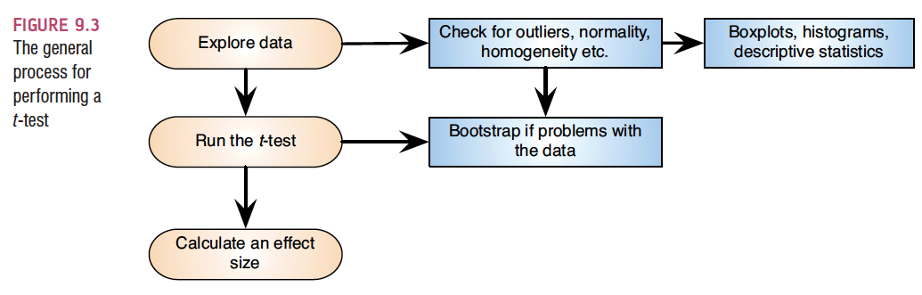
Independent t-test using SPSS

Slide 27
Independent t-test Example
Survey.dat (Julie Pallant)
Dataset created from a designed to explore the factors that impact on respondents’ psychological adjustment and wellbeing.
Question:
Is there a significant difference in the mean self-esteem scores for males and females?
Need
One categorical variable (male/female gender)
One continuous, dependent variable (self-esteem score tslfest)
T-test
Will tell you whether there is a statistically significant difference between the mean scores of the groups

Slide 28
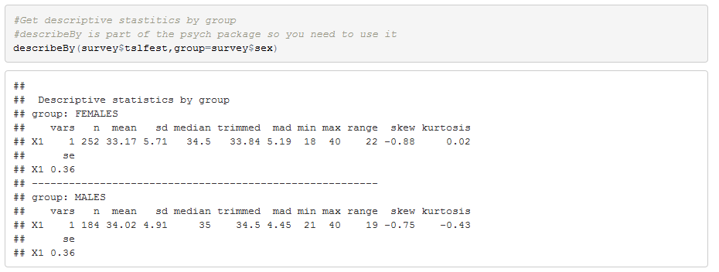
Independent t-test in R
We need to look at the descriptive statistics for the variable by group

Slide 29
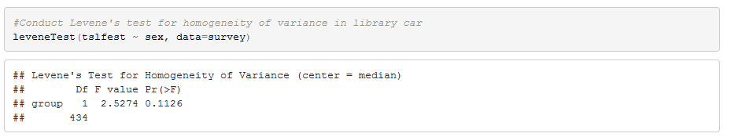
Independent t-test in R
We need to know the homogeneity of variance in advance so we can set the parameter on the t-test so we conduct the Levene’s test first
The null hypothesis is that all variances are equal. A resulting p-value under 0.05 means that variances are not equal and than further parametric tests are not suitable.
Note that this test is meant to be used with normally distributed data but can tolerate relatively low deviation from normality.

Slide 30
Testing for Homogeneity of Variance
In R you need to choose and test in advance of running other tests
Levene’s test is best – this is the most robust test for normally distributed data. Null hypothesis is that the variance is equal.
Fligner-Killeen test - this is a non-parametric test equivalent.
To run in R
Levene’s is in the library car
library(car)
leveneTest(continuousvariable ~ categoricalvariable, data=dataframename)
E.g.
leveneTest(tslfest~sex,data=sdata)
Gives as output an F statistic and an estimate of significance

Slide 31
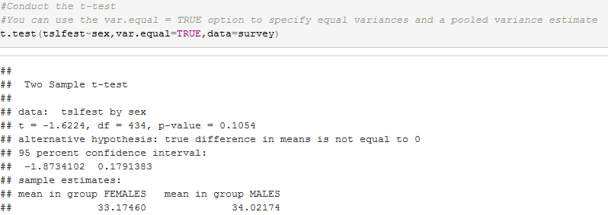
Independent t-test in R
Conduct the t-test: t.test( ) function produces a variety of t-tests.
t.test(y~x) # where y is numeric and x is a binary factor
Unlike most statistical packages, the default assumes unequal variance and applies the Welsh df modification.
You can use the var.equal = TRUE option to specify equal variances and a pooled variance estimate.

Slide 32
Independent t-test in R
Look also at the mean difference

Slide 33
Calculating effect size
Cohen’s d
Value for a between subjects t test and the degrees of freedom.
Cohen's d = 2t /√(df)
In this case d= 0.155
Reporting Cohen’s d
0.2=small effect, 0.5=moderate, 0.8 = large
NOTE: Choice of using eta squared or Cohen’s d depends on your field of study

Slide 34
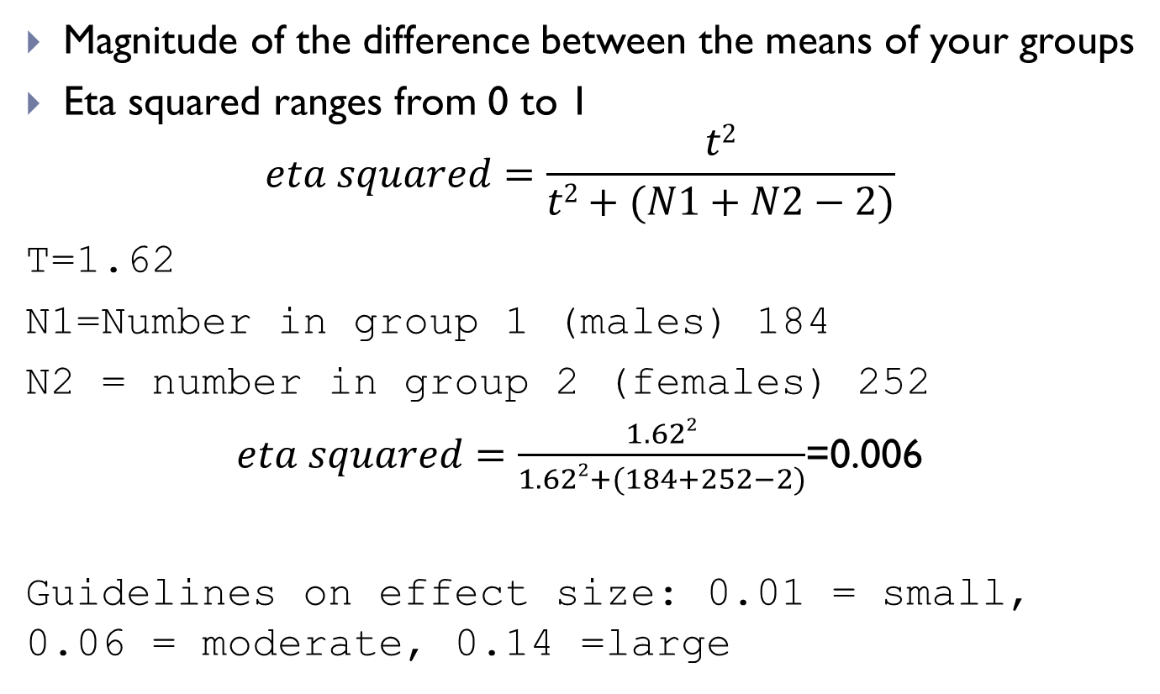
Calculating effect size
Magnitude of the difference between the means of your groups
Eta squared ranges from 0 to 1
$$eta squared=\frac{t2}{t2+(N1+N2−2)}$$
T=1.62
N1=Number in group 1 (males) 184
N2 = number in group 2 (females) 252
$eta squared=\frac{1.622}{1.622+(184+252−2)}$=0.006
Guidelines on effect size: 0.01 = small, 0.06 = moderate, 0.14 =large

Slide 35
Reporting a t-test
“An independent-samples t-test was conducted to compare self-esteem scores for male and female respondents. No significant difference in the scores for self-esteem was found (M=33.17, SD= 5.71 for female respondents, M= 34.02, SD= 4.91for male respondents), (t(434)= -1.62, p = 0.10). The eta square statistic also indicated a very small effect size (0.006).”

Slide 36
Assumptions for Non-Parametric Tests
Random samples
Independent observations
Each case is counted only once
Unless it is a repeated measure where the same participants are retested on different occasions or under different conditions

Slide 37
Non-Parametric Example from Andy Field
Our neurologist investigating the depressant effects of certain alcoholic drinks:
Tested 20 clubbers
10 were allowed to drink only vodka on a Saturday night
10 were allowed to drink only beer.
Levels of depression were measured using the Beck Depression Inventory (BDI) the day after and midweek.
We are hypothesising that two groups of different entities will differ on the result of a test for depression.
A similar number of high and low ranks in each group would suggest depression levels do not differ between the groups.
A greater number of high ranks in the vodka group than the beer group would suggest the vodka group is more depressed than the beer group.
Field-BDI-NonParametric.dat

Slide 38
Non-Parametric: Comparing two independent conditions
This requires us to fit a model that compares the distribution of this variable for those in the beer group and the vodka group.
Requires us to test differences between two conditions in which different participants have been used.
To compare the distribution of two conditions and these conditions then you can use:
The Mann-Whitney test and
Wilcoxon’s Rank-sum test
These work on ranking data.

Slide 39
Ranking Data
The tests work on the principle of ranking the data for each group:
Lowest score = a rank of 1,
Next highest score = a rank of 2, and so on.
Tied ranks are given the same rank: the average of the potential ranks.
For an unequal group size the test statistic (Ws) = sum of ranks in the group that contains the least people.
For an equal group size the test statistic Ws = the value of the smaller summed rank.
Add up the ranks for the two groups and take the lowest of these sums to be our test statistic.
The analysis is carried out on the ranks rather than the actual data.

Slide 40
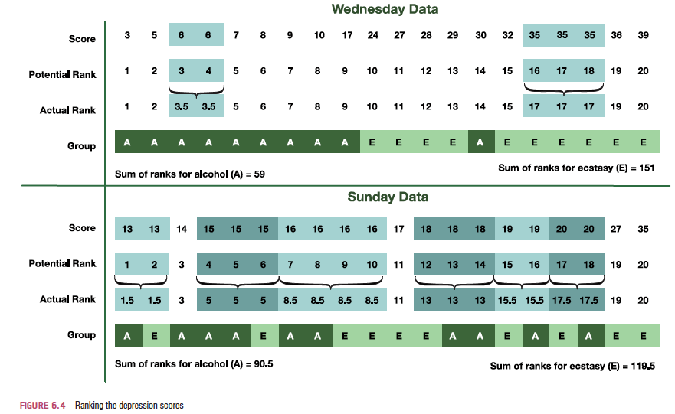
Ranking the Depression scores for Wednesday and Sunday
Sum of ranks for Vodka=59
Sum of ranks for Beer=151
Sum of ranks for Vodka=90.5
Sum of ranks for Beer=119.5

Slide 41
Provisional analysis using R
Load the data
drinkset<- read.table("C:/tempR/Field-BDI-Non-parametric.dat")
Get your descriptive statistics
describeBy(drinkset$bdisun,group=drinkset$drink)
Create your plots using ggplot

Slide 42
Mann-Whitney test
It is used to test the null hypothesis that two samples come from the same population (i.e. have the same median)
OR alternatively, whether observations in one sample tend to be larger than observations in the other.
Compares the medians from two populations and works when the Y variable is continuous and the X variable is discrete with two attributes.
Of course, the Mann-Whitney test can also be used for normally distributed data, but in that case it is less powerful than the 2-sample t-test.

Slide 43
The U Value
The U value for each group is calculated by subtracting the possible minimum rank which the group can take from the sum of the ranks, and the smallest U value is used for the test.
For the test of significance of the Mann-Whitney U-test it is assumed that with n > 80 or each of the two samples at least > 30 the distribution of the U-value from the sample approximates normal distribution.
U value is compared to table of critical values depending on the size of each sample
U value must be equal to or less than critical value

Slide 44
In R – Mann Whitney U (Wilcoxon Test)
From stats package
wilcox.test(y~A)#where y is your continuous variable and A
is your categorical
drinkset<- read.table('Field-BDI-Non-parametric.dat')
wilcox.test(bdisun~drink, data=drinkset) Warning in wilcox.test.default(x = c(16L, 15L, 20L, 15L, 16L, 13L, 14L, : cannot compute exact p-value with ties
Wilcoxon rank sum test with continuity correction data: bdisun by drink
W = 35.5, p-value = 0.2861 alternative hypothesis: true location shift is not equal to 0
wilcox.test(bdiwed~drink, data=drinkset)
Warning in wilcox.test.default(x = c(5L, 6L, 30L, 8L, 9L, 7L, 6L, 17L, 3L, : cannot compute exact p-value with ties Wilcoxon rank sum test with continuity correction data: bdiwed by drink
W = 4, p-value = 0.000569 alternative hypothesis: true location shift is not equal to 0

Slide 45
Calculating an Effect Size
The equation to convert a z-score into the effect size estimate, r, is as follows (from Rosenthal, 1991: 19):
z is something we need to calculate if we use the stats package
We can use qnorm() of the pvalue to get it
Rosenthal 1991 Meta-analytic procedures for social research, SAGE

Slide 46
In R – Calculate effect size
Calculate the standardised z statistic Z and call it Zstat Zstat<-qnorm(test$p.value/2)
Calculate the effect size using abs(Zstat)/sqrt(20)
#20 is the number in the study
abs(Zstat)/sqrt(20)
[1] 0.8737202

Slide 47
In R – Mann Whitney U
From coin package
wilcox.test(y~A)#where y is your continuous variable and A
is your categorical
drinkset<- read.table('Field-BDI-Non-parametric.dat')
Coin::Wilcox_test(bdisun~drink, data=drinkset)
Asymptotic Wilcoxon-Mann-Whitney Test data: bdisun by drink (Beer, Vodka)
Z = -1.1049, p-value = 0.2692
alternative hypothesis: true mu is not equal to 0
Wilcox_test(bdiwed~drink, data=drinkset)
Asymptotic Wilcoxon-Mann-Whitney Test data: bdiwed by drink (Beer, Vodka)
Z = -3.4838, p-value = 0.0004943
alternative hypothesis: true mu is not equal to 0

Slide 48


Calculating an Effect Size
The equation to convert a z-score into the effect size estimate, r, is as follows (from Rosenthal, 1991: 19):
z is something we need to calculate if we use the stats package
N is the size of the study (i.e. the number of total observations)
We had 10 vodka users and 10 beer users and so the total number of observations was 20.
Rounded value of Z
Rosenthal 1991 Meta-analytic procedures for social research, SAGE

Slide 49
Reporting the Results
For the Mann–Whitney test:
Depression levels in vodka users (Mdn = 17.50) did not differ significantly from beer users (Mdn = 16.00) the day after the drugs were taken, (U = 35.50, z = −1.11, p = .280, r = −.25). However, by Wednesday, vodka users (Mdn = 33.50) were significantly more depressed than beer users (Mdn = 7.50), (U = 4.00, z = −3.48, p < .001, r = −.78).
NOTE
Our W statistic is what we use for U
We report the median values because the data is not normally distributed.

Slide 50
Repeated Measures

Slide 51
Parametric: Paired samples t-test
Also referred to as repeated measures test
Collect data from one group on two different occasions or under different conditions

Slide 52
Paired Samples t-test
Using Pallant’s experim.dat (also available as a dataset for R experim.dat)
Investigating the impact of an intervention designed to increase student confidence in their ability to survive a statistics course
Students completed a Fear of Statistics Test at Time 1 (FOST2) (before the intervention) and Time 2 (FOST2) (after the intervention)
Question
Is there a significant change in participant’s Fear of Statistics Test scores following participation in an intervention designed to increase students confidence in their ability to complete a statistics course?
Does this intervention have an impact on participants’ Fear of Statistics Test scores?

Slide 53
Paired Samples t-test
Need
One categorical independent variable (in this case Time with two different levels Time 1 and Time 2)
One continuous dependent variable (Fear of Statistics score) measured on two different occasions or under different conditions (FOST1 and FOST2)
What will a paired samples t-test do?
Will tell you whether there is a statistically significant difference between the mean scores for Time 1 and Time 2
Non-parametric alternative = Wilcoxon Signed Rank Test

Slide 54
In R
Paired T-test:
t.test(y1,y2,paired=TRUE) # where y1 & y2 are numeric
edata<-read.table('experim.dat')
For our example:
t.test(edata$fost1,edata$fost2,paired=TRUE)
Output:
data: edata$fost1 and edata$fost2 t = 5.3936, df = 29, p-value = 8.498e-06
alternative hypothesis: true difference in means is not equal to 0
95 percent confidence interval: 1.655478 3.677855
sample estimates: mean of the differences 2.666667

Slide 55
Interpreting our output
t = 5.3936, df = 29, p-value = 8.498e-06
sample estimates: mean of the differences 2.666667
We have established a significant difference to the level of 2.67 (rounded)
Having established a significant difference, establish which set of scores are higher
Look at Paired Sample Statistics
Mean @ Time 1=40.17, Mean @Time 2=37.50
Conclude there was a significant decrease from Time 1 to Time 2
We cannot however conclude that the intervention caused this!

Slide 56

Calculating an Effect Size
eta squared = $\frac{t2}{t2+(N−1)}=\frac{\left(5.39\right)2}{\left(5.39\right)2+(30−1)}$=0.50
Cohen’s guidelines
.01 = small
.06 = moderate
.014=large

Slide 57
Reporting paired t-test
“A paired-samples t-test was conducted to evaluate the impact of the intervention on students’ scores on the Fear of Statistics Test (FOST). There was a statistically significant decrease in FOST scores from Time 1 (M=40.17, SD=5.16) to Time 2 (M=37.5, SD=5.15), t (29)=5.29, p<.001). The mean decrease in FOST scores was 2.67 with a 95% confidence interval ranging from 1.66 to 3.68. The eta squared statistic (.50) indicated a large effect size.”

Slide 58
Non-Parametric Data: the Wilcoxon signed-rank test
Uses:
To compare two sets of scores, when these scores come from the same participants.
Using our data on clubbers FieldBDINonParametric.sav (or .dat)
Imagine the experimenter was interested in the change in depression levels for each drink.
Non-parametric test because the distributions of scores for both drinks were non-normal on one of the days.
Only want the scores for vodka
Need to select the cases for vodka
Or split the file

Slide 59
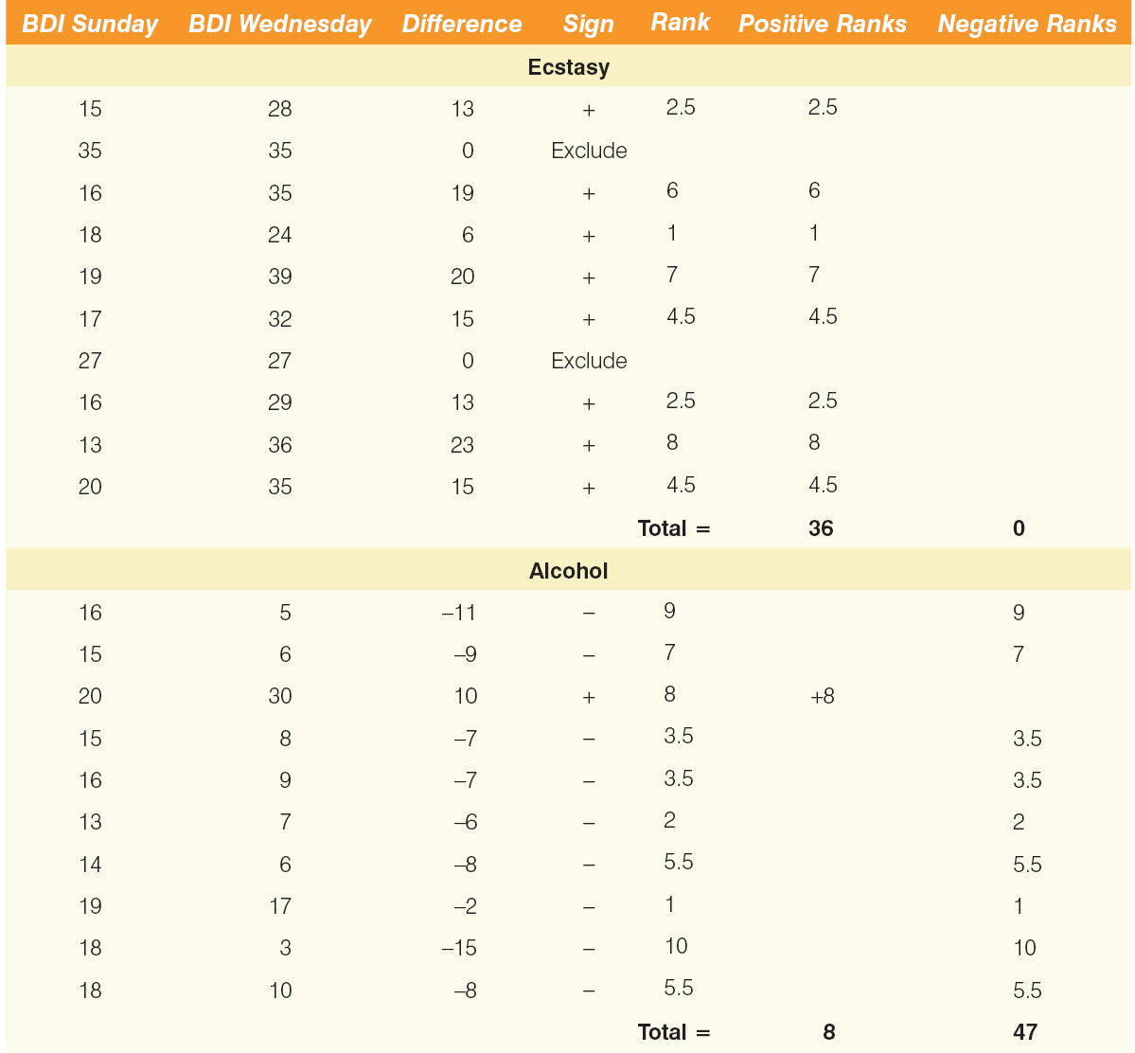
Ranking data in the Wilcoxon signed-rank test

Slide 60
In R dependent 2-group Wilcoxon Signed Rank Test
Need to split the file or subset it and run against each sub-set
vodkadata<-subset(drinkset,drinkset$drink=='Vodka')
beerdata<-subset(drinkset,drinkset$drink=='Beer')
Wilcoxon test syntax
wilcox.test(y1,y2,paired=TRUE)
Example:
stats::wilcox.test(beerdata$bdisun,beerdata$bdiwed,paired=TRUE)
Output
Wilcoxon signed rank test with continuity correction
data: beerdata$bdisun and beerdata$bdiwed
V = 47, p-value = 0.05248 alternative hypothesis: true location shift is not equal to 0
The value V = 0 corresponds to the sum of ranks assigned to the differences with positive sign

Slide 61
Calculating an Effect size
The effect size can be calculated in the same way as for the Mann–Whitney test.
Again calculate Z
For the vodka group z is 2.53, and for the beer group is −1.99.
In both cases we had 20 observations
(although we only used 10 people and tested them twice, it is the number of observations, not the number of people, that is important here).
The effect size is therefore 2.53/√20 =0.57, -1.99/ √20 =-0.44

Slide 62
Reporting the results
Reporting Test-Statistic:
For vodka users depression levels were significantly higher on Wednesday (Mdn = 33.50) than on Sunday (Mdn = 17.50), T = 36, p = .012, r = 0.57. However, for beer users the opposite was true: depression levels were significantly lower on Wednesday (Mdn = 7.50) than on Sunday (Mdn = 16.0), T = 8, p = .047, r = −0.44.

Slide 63
Reporting the results
Reporting the values of z:
For vodka users, depression levels were significantly higher on Wednesday (Mdn = 33.50) than on Sunday (Mdn = 17.50), z = 2.53, p = .012, r = 0.57. However, for beer users the opposite was true: depression levels were significantly lower on Wednesday (Mdn = 7.50) than on Sunday (Mdn = 16.0), z = −1.99, p = .047, r = −0.44.

Slide 64
Back to Hypothesis Testing

Slide 65
Errors in Hypothesis Tests
Just because we find a statistically significant difference/effect does not necessarily indicate there is a causal relationship.
Because the hypothesis test relies on sample data, and because sample data are not completely reliable, there is always the risk that misleading data will cause the hypothesis test to reach a wrong conclusion.

Slide 66
Type I Errors
Occur when the sample data appear to show an effect/difference when, in fact, there is none in the population.
In this case the researcher will reject the null hypothesis and falsely conclude that there is an effect/difference.
Type I errors are caused by unusual, unrepresentative samples.
Just by chance the researcher selects an extreme sample with the result that the sample falls in the critical region even though there is no effect.
The hypothesis test is structured so that Type I errors are very unlikely
Specifically, the probability of a Type I error is equal to the alpha level.

Slide 67
Type II Errors
Occurs when the sample does not appear to have an effect/difference when in fact this exists in the population.
In this case, the researcher will fail to reject the null hypothesis.
Type II errors are commonly the result of a very small effects/differences (not large enough to show up in the research study).

Slide 68
Power of a Hypothesis Test
The power β of a hypothesis test is defined is the probability that the test will reject the null hypothesis when there is no effect.
The power of a test depends on a variety of factors including the size of the effect and the size of the sample.

Slide 69
Possible Error…?
Compare Type I and Type II error like this:
The only concern when you find statistical significance (p < 0.05) is Type I Error
Is the difference between groups REAL or due to Random Sampling Error
Thankfully, the p-value tells you exactly what the probability of that random sampling error is
In other words, the p-value tells you how likely Type I error is
But, does the p-value tell you how likely Type II error is?
The probability of Type II error is better provided by Power

Slide 70
Possible Error…?
Probability of Type II error is provided by Power
Statistical Power, also known as β (Beta) (actually 1 – β)
Power (Beta) is related to Alpha, but:
Alpha is the probability of having Type I error
Lower number is better (i.e., 0.05 vs 0.01 vs 0.001)
Power is the probability of NOT having Type II error
The probability of being right (correctly rejecting the null hypothesis)
Higher number is better (typical goal is 0.80)

Slide 71
Should it be statistically significant?
The most obvious thing you need to consider is if you REALLY should have found a statistically significant result?
Just because you wanted your test to be significant doesn’t mean it should be
This wouldn’t be Type II error – it would just be the correct decision

